Slide 1
Unix Shell Scripting

Slide 2
Introduction to Shell Scripting
Normally shells are interactive
It means shell accept commands from you (via keyboard) and execute them
But if you use command one by one (sequence of 'n' number of commands) , then you can store this sequence of command to text file and tell the shell to execute this text file instead of entering the commands.
This is know as shell script.
Notes:
Unix is a very popular multi-user, multitasking, time-sharing operating system.
Unix has become the operating system of choice for various engineering and scientific applications. The need for Unix could be determined by the different categories of application it suffices. viz. networking, programming, multimedia, high-performance computing to name a few.
The chronology of events that led to the evolution of Unix are as follows:
1965 : AT&T, GE, IBM and Project MAC join together to develop a time-sharing system named MULTICS (Multiplexed Information and Computing Service).
1969 : AT&T Bell Labs drops out of MULTICS project. Ken Thompson writes first version of UNICS on a PDP-7 machine. UNICS is pun on MULTICS and stands for Uniplexed Information and Computing Services. UNICS is changed to UNIX.
1973 : Re-written in high level language C, thus making it machine-independent.
1977-1981 : Unix was widely available at minimal cost and became popular for scientific applications.
1982 : Unix System III is released.
1984-85 : Unix System V is released.
1992-93 : 4.4 BSD is released.
1994 : Linux 1.0 is released.
2001 : Linux 2.4 is released.

Slide 3
Shell script is defined as:
"Shell Script is series of commands written in plain text file. Shell script is just like batch file in MS-DOS but have more power than the MS-DOS batch file."

Slide 4
Why to Write Shell Script ?
Shell script can take input from user, file and output them on screen.
Useful to create our own commands.
Save lots of time.
To automate some task of day today life.
System Administration part can be also automated.

Slide 5
How to write shell script
Following steps are required to write shell script:
  Use any editor to write shell script.
  After writing shell script set execute permission for your script as follows
  syntax:
  $chmod permission your-script-name
  Examples:
  $ chmod +x your-script-name
  $ chmod 755 your-script-name

Slide 6
How to write shell script cont …
  Execute your script as
  syntax:
  bash your-script-name
  sh your-script-name
  ./your-script-name
  Examples:
  $ bash bar
  $ sh bar
  $ ./bar

Slide 7
First Shell Script
Now you are ready to write first shell script that will print "Knowledge is Power" on screen.
$ vi first
#
# My first shell script
#
clear
echo "Knowledge is Power"

Slide 8
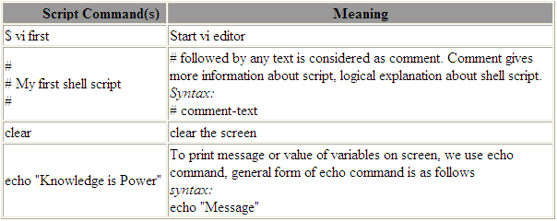
Explanation
Tip: For shell script file try to give file extension such as .sh, which can be easily identified by you as shell script.

Slide 9
Practice
Write following shell script, save it, execute it and note down the it's output.
$ vi ginfo
#
#
# Script to print users information who are currently logged in , current date & time
#
clear
echo "Hello $USER"
echo "Today is \c";date
echo "Number of users logged in : \c” ; who | wc –l
echo “Calendar”
cal

Slide 10
Variables in Shell
To process our data/information, data must be kept in computers memory
memory is divided into small locations, and each location has unique number called memory location/address, which is used to hold our data
Programmer can give a unique name to this memory location/address called memory variable or variable (Its a named storage location that may take different values, but only one at a time).

Slide 11
Variables in Shell cont …
In Shell, there are two types of variables:
  System variables - Created and maintained by system itself. These types of variables are defined in CAPITAL LETTERS.
  User defined variables (UDV) - Created and maintained by user. These types of variables are defined in lower case letters.

Slide 12
Variables in Shell cont …
Variables are further divided into two types
  Local or shell variable
    Valid in current shell
    $set
    echo $HOME
  Environment variable
    Passed to sub-shell and programs
    $env

Slide 13
Defining UDV(User Defined Variable)
To define UDV use following syntax
Syntax:
variable name=value
'value' is assigned to given 'variable name' and Value must be on right side = sign.
Example:
$ no=10# this is ok
$ 10=no# Error, NOT Ok, Value must be on right side of = sign.
To define variable called 'vech' having value Bus
$ vech=Bus
To define variable called n having value 10
$ n=10

Slide 14
Rules for Naming variable name
Variable name must begin with Alphanumeric character or underscore character in between (_), followed by one or more Alphanumeric character. For e.g. Valid shell variable are as follows
HOME
SYSTEM_VERSION
vech
no

Slide 15
Rules for Naming variable name cont …
Don't put spaces on either side of the equal sign when assigning value to variable. For e.g. In following variable declaration there will be no error
$ no=10
But there will be problem for any of the following variable declaration:
$ no =10
$ no= 10
$ no = 10

Slide 16
Rules for Naming variable name cont …
Variables are case-sensitive, just like filename in Unix. For e.g.
$ no=10
$ No=11
$ NO=20
$ nO=2
All above are different variable names, so to print value 20 we have to use $ echo $NO and not any of the following:
$ echo $no # will print 10 but not 20
$ echo $No# will print 11 but not 20
$ echo $nO# will print 2 but not 20

Slide 17
Rules for Naming variable name cont …
You can define NULL variable as follows (NULL variable is variable which has no value at the time of definition) For e.g.
$ vech=
$ vech=""
Try to print it's value by issuing following command
$ echo $vech
Nothing will be printed because variable has no value i.e. NULL variable.
Do not use ?,* etc, to name your variables

Slide 18
Printing UDV values
To print or access UDV use following syntax
Syntax:
$variablename
Define variable vech and n as follows:
$ vech=Bus
$ n=10
To print contains of variable 'vech' type
$ echo $vech
It will print 'Bus', To print value of variable 'n' type command as follows
$ echo $n

Slide 19
Exercise
Q.1.How to Define variable x with value 10 and print it on screen.
Q.2.How to Define variable xn with value Rani and print it on screen
Q.3.How to print sum of two numbers, let's say 6 and 3?
Q.4.How to define two variable x=20, y=5 and then to print division of x and y (i.e. x/y)
Q.5.Modify above and store division of x and y to variable called z
Q.6.Point out error if any in following script

Slide 20
Exercise
Q.6.Point out error if any in following script
vi variscript
#
#
# Script to test MY knowledge about variables!
#
myname=Aftab
myos = TroubleOS
myno=5
echo "My name is $myname"
echo "My os is $myos"
echo "My number is myno, can you see this number"

Slide 21
echo Command
Use echo command to display text or value of variable.
echo [options] [string, variables...]
Options
-n Do not output the trailing new line.
-e Enable interpretation of the following backslash escaped characters in the strings:
\a alert (bell)
\b backspace
\c suppress trailing new line
\n new line
\r carriage return
\t horizontal tab
\\ backslash
For e.g. $ echo -e "An apple a day keeps away \a\t\tdoctor\n"

Slide 22
Shell Arithmetic
Used to perform arithmetic operations.
Syntax:
expr op1 math-operator op2
Examples:
$ expr 1 + 3
$ expr 2 - 1
$ expr 10 / 2
$ expr 20 % 3
$ expr 10 \* 3
$ echo `expr 6 + 3`
Note:
expr 20 %3 - Remainder read as 20 mod 3 and remainder is 2.
expr 10 \* 3 - Multiplication use \* and not * since its wild card.

Slide 23
Shell Arithmetic cont …
$ echo `expr 6 + 3`
For the above statement, note the following points:
  First, before expr keyword we used ` (back quote) sign not the (single quote i.e. ') sign.
  Back quote is generally found on the key under tilde (~) on PC keyboard OR to the above of TAB key.
  Second, expr is also end with ` i.e. back quote.
  Here expr 6 + 3 is evaluated to 9, then echo command prints 9 as sum
  Here if you use double quote or single quote, it will NOT work
For e.g.
$ echo "expr 6 + 3" # It will print expr 6 + 3
$ echo 'expr 6 + 3' # It will print expr 6 + 3

Slide 24
Exit Status
By default in Unix if particular command/shell script is executed, it return two type of values which is used to see whether command or shell script executed is successful or not.
If return value is zero (0), command is successful.
If return value is nonzero, command is not successful or some sort of error executing command/shell script
This value is know as Exit Status.
But how to find out exit status of command or shell script?
Simple, to determine this exit Status you can use $? special variable of shell.

Slide 25
Exit Status cont …
For e.g. (This example assumes that unknow1file doest not exist on your hard drive)
$ rm unknow1file
It will show error as follows
rm: cannot remove `unkowm1file': No such file or directory
and after that if you give command
$ echo $?
it will print nonzero value to indicate error. Now give command
$ ls
$ echo $?
It will print 0 to indicate command is successful.

Slide 26
Exercise
Try the following commands and not down the exit status:
$ expr 1 + 3
$ echo $?
$ echo Welcome
$ echo $?
$ wildwest canwork?
$ echo $?
$ date
$ echo $?
$ echon $?
$ echo $?

Slide 27
Shell built in variables
$# Number of command line arguments. Useful to test no. of command line args in shell script.
$* All arguments to shell
$@ Same as above
$- Option supplied to shell
$$ PID of shell
$! PID of last started background process (started with &)

Slide 28
The read Statement
Used to get input (data from user) from keyboard and store (data) to variable.
Syntax:
read variable
Example:
$ vi sayh
#
#Script to read your name from key-board
#
echo "Your first name please:"
read fname
echo "Hello $fname, Lets be friend!"

Slide 29
Wild cards (Filename Shorthand or meta Characters)
* Matches any string or group of characters.
  $ ls * will show all files
  $ ls a* will show all files whose first name is starting with letter ‘a’
  $ ls *.c will show all files having extension .c
  $ ls ut*.c will show all files having extension .c but file name must begin with 'ut'.

Slide 30
Wild cards (Filename Shorthand or meta Characters) cont …
? Matches any single character.
  $ ls ? will show all files whose names are 1 character long
  $ ls fo? will show all files whose names are 3 character long and file name begin with fo
[...] Matches any one of the enclosed characters
  $ ls [abc]* will show all files beginning with letters a,b,c

Slide 31
Wild cards (Filename Shorthand or meta Characters) cont …
Examples
Note:
[..-..] A pair of characters separated by a minus sign denotes a range.
Example:
$ ls /bin/[a-c]*
Will show all files name beginning with letter a,b or c
But
$ ls /bin/[!a-o]
$ ls /bin/[^a-o]
If the first character following the [ is a ! or a ^ ,then any character not enclosed is matched i.e. do not show us file name that beginning with a,b,c,e...o

Slide 32
More command on one command line
Syntax:
command1;command2
To run two command with one command line.
Examples:
$ date;who
Will print today's date followed by users who are currently logged in. Note that You can't use
$ date who
for same purpose, you must put semicolon in between date and who command.

Slide 33
Command Line Processing
Try the following command (assumes that the file "grate_stories_of" does not exist on your system)
$ ls grate_stories_of
It will print message something like - grate_stories_of: No such file or directory.
The first word on command line is, ls - is name of the command to be executed.
Everything else on command line is taken as arguments to this command. For e.g.
$ tail +10 myf
Name of command is tail, and the arguments are +10 and myf.

Slide 34
Exercise
Exercise
Try to determine command and arguments from following commands
$ ls foo
$ cp y y.bak
$ mv y.bak y.okay
$ tail -10 myf
$ mail raj
$ sort -r -n myf
$ date
$ clear
NOTE:
$# holds number of arguments specified on command line. And $* or $@ refer to all arguments passed to script.

Slide 35
Why Command Line arguments required
Telling the command/utility which option to use.
Informing the utility/command which file or group of files to process (reading/writing of files).

Slide 36
Command Line Arguments
Lets take ls command
$ Ls -a /*
This command has 2 command line arguments. First, -a and /* is another.

Slide 37

Command Line Arguments cont …
For shell script,
$ myshell foo bar
    Shell Script name i.e. myshell
    First command line argument passed to myshell i.e. foo
    Second command line argument passed to myshell i.e. bar

Slide 38
Command Line Arguments cont …
  In shell if we wish to refer this command line argument we refer above as follows
  myshell it is $0
  foo it is $1
  bar it is $2

Slide 39
Command Line Arguments cont …
Here $# (built in shell variable ) will be 2 (Since foo and bar only two Arguments), Please note at a time such 9 arguments can be used from $1..$9, You can also refer all of them by using $* (which expand to `$1,$2...$9`). Note that $1..$9 i.e command line arguments to shell script is know as "positional parameters".

Slide 40
Exercise
Use following script to print command line arguments and to see how to access them:
$ vi demo
#!/bin/sh
#
# Script that demos, command line args
#
echo "Total number of command line arguments are $#"
echo "$0 is script name"
echo "$1 is first argument"
echo "$2 is second argument"
echo "All of them are :- $* or $@“
Run it & test it as follows:
$ ./demo Hello World

Slide 41
Input - Output redirection
Mostly all command gives output on screen or take input from keyboard, but in Unix (and in other OSs also) it's possible to send output to file or to read input from file.
For e.g.
$ ls command gives output to screen; to send output to file of ls command give command
$ ls > filename
It means put output of ls command to filename

Slide 42
Input - Output redirection cont …
There are three main redirection symbols >,>>,<
> Redirector Symbol
Syntax:
Unix-command > filename
$ ls > myfiles
>> Redirector Symbol
Syntax:
Linux-command >> filename
$ date >> myfiles

Slide 43
Input - Output redirection cont …
  < Redirector Symbol
  Syntax:
  Unix-command < filename
  To take input to Unix-command from file instead of key-board. For e.g. To take input for cat command give
  $ cat < myfiles

Slide 44
Exercise
  $cat > sname
  aftab
  ashish
  zebra
  babu
  Press CTRL + D to save.
  Now issue following command.
  $ sort < sname > sorted_names
  $ cat sorted_names
  aftab
  ashish
  babu
  zebra

Slide 45
Exercise cont …
Try one more example to clear your idea:
$ tr "[a-z]" "[A-Z]" < sname > cap_names
$ cat cap_names
AFTAB
ASHISH
ZEBRA
BABU

Slide 46
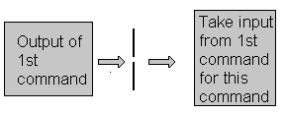
Pipes
A pipe is a way to connect the output of one program to the input of another program without any temporary file

Slide 47
Pipes cont …
Pipe Defined as:
"A pipe is nothing but a temporary storage place where the output of one command is stored and then passed as the input for second command. Pipes are used to run more than two commands ( Multiple commands) from same command line."
Syntax:
command1 | command2

Slide 48
Decision Making
Making decision is important part in ONCE life as well as in computers logical driven program.
In fact logic is not LOGIC until you use decision making.
This chapter introduces to the bashs structured language constricts such as:
  Decision making
  Loops

Slide 49
Decision Making cont …
Is there any difference making decision in Real life and with Computers?
Well real life decision are quit complicated to all of us and computers even don't have that much power to understand our real life decisions.
What computer know is 0 (zero) and 1 that is Yes or No. To make this idea clear, lets play some game (WOW!) with bc - Unix calculator program.

Slide 50
Decision Making cont …
$ bc
After this command bc is started and waiting for your commands, i.e. give it some calculation as follows type 5 + 2 as:
5 + 2
7
7 is response of bc i.e. addition of 5 + 2 you can even try
5 - 2
5 / 2
See what happened if you type 5 > 2 as follows
5 > 2
1
1 (One?) is response of bc, How? bc compare 5 with 2 as, Is 5 is greater then 2, (If I ask same question to you, your answer will be YES), bc gives this 'YES' answer by showing 1 value.

Slide 51
Decision Making cont …
Now try
5 < 2
0
0 (Zero) indicates the false i.e. Is 5 is less than 2?, Your answer will be no which is indicated by bc by showing 0 (Zero). Remember in bc, relational expression always returns true (1) or false (0 - zero).
Try following in bc to clear your Idea and note down bc's response
5 > 12
5 == 10
5 != 2
5 == 5
12 < 2

Slide 52
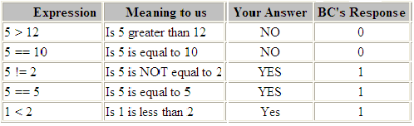
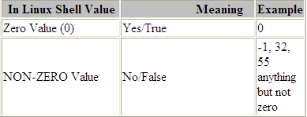
Decision Making cont …

Slide 53

Decision Making cont …
Remember both bc and Unix Shell uses different ways to show True/False values

Slide 54
if condition
if condition which is used for decision making in shell script, If given condition is true then command1 is executed.
Syntax:
if condition
then
command1 if condition is true or if exit status of condition is 0 (zero)
...
...
fi

Slide 55
if condition
Expreession is defined as:
"An expression is nothing but combination of values, relational operator (such as >,<, <> etc) and mathematical operators (such as +, -, / etc )."
Following are all examples of expression:
5 > 2
3 + 6
3 * 65
a < b
c > 5
c > 5 + 30 -1

Slide 56
Example
Type following commands (assumes you have file called foo)
$ cat foo
$ echo $?
The cat command return zero(0) i.e. exit status, on successful, this can be used, in if condition as follows, Write shell script as
$ cat > showfile
#!/bin/sh
#
#Script to print file
#
if cat $1
then
echo -e "\n\nFile $1, found and successfully echoed"
fi
$./showfile foo

Slide 57
Exercise
Write shell script as follows:
cat > trmif
#
# Script to test rm command and exit status
#
if rm $1
then
echo "$1 file deleted"
fi

Slide 58
test command or [ expr ]
test command or [ expr ] is used to see if an expression is true, and if it is true it return zero(0), otherwise returns nonzero for false.
Syntax:
test expression OR [ expression ]

Slide 59
test command or [ expr ] cont …
Example:
Following script determine whether given argument number is positive.
$ cat > ispostive
#!/bin/sh
#
# Script to see whether argument is positive
#
if test $1 -ge 0
then
echo "$1 number is positive"
fi
$ ispostive 5

Slide 60
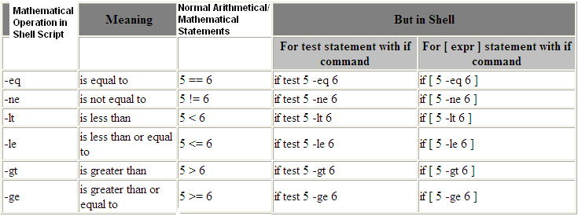
test command or [ expr ] cont …
test or [ expr ] works with
1.Integer ( Number without decimal point)
2.File types
3.Character strings

Slide 61
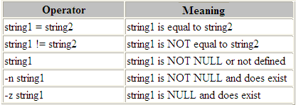
test command or [ expr ] cont …
For string Comparisons use

Slide 62
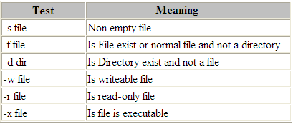
test command or [ expr ] cont …
Shell also test for file and directory types

Slide 63

test command or [ expr ] cont …
Logical Operators
Logical operators are used to combine two or more condition at a time

Slide 64
if...else...fi
If given condition is true then command1 is executed otherwise command2 is executed.
Syntax:
if condition
then
condition is zero (true - 0)
execute all commands up to else statement
else
if condition is not true then execute all commands up to fi
fi

Slide 65
if...else...fi example
$ vi isnumpn
#!/bin/sh
#
# Script to see whether argument is positive or negative
#
if [ $# -eq 0 ]
then
echo "$0 : You must give/supply one integers"
exit 1
fi
if test $1 -gt 0
then
echo "$1 number is positive"
else
echo "$1 number is negative"
fi

Slide 66
Nested if-else-fi
You can write the entire if-else construct within either the body of the if statement of the body of an else statement. This is called the nesting of ifs.

Slide 67
Nested if-else-fi example
$ vi nestedif.sh
osch=0
echo "1. Unix (Sun Os)"
echo "2. Linux (Red Hat)"
echo -n "Select your os choice [1 or 2]? "
read osch
if [ $osch -eq 1 ] ; then
echo "You Pick up Unix (Sun Os)"
else #### nested if i.e. if within if ######
if [ $osch -eq 2 ] ; then
echo "You Pick up Linux (Red Hat)"
else
echo "What you don't like Unix/Linux OS."
fi
fi

Slide 68
Multilevel if-then-else example
$ cat > elf
#
#!/bin/sh
# Script to test if..elif...else
#
if [ $1 -gt 0 ]; then
echo "$1 is positive"
elif [ $1 -lt 0 ]
then
echo "$1 is negative"
elif [ $1 -eq 0 ]
then
echo "$1 is zero"
else
echo "Opps! $1 is not number, give number"
fi

Slide 69
if...else...fi example
Try it as follows:
$ chmod 755 isnump_n
$ isnump_n 5
5 number is positive
$ isnump_n -45
-45 number is negative
$ isnump_n
./ispos_n : You must give/supply one integers
$ isnump_n 0
0 number is negative

Slide 70
Loops in Shell Scripts
Loop defined as:
"Computer can repeat particular instruction again and again, until particular condition satisfies. A group of instruction that is executed repeatedly is called a loop.“
Bash supports:
  for loop
  while loop

Slide 71
for Loop
Syntax:
for { variable name } in { list }
do
execute one for each item in the list until the list is not finished (And repeat all statement between do and done)
done

Slide 72
for Loop example
$ cat > testfor
for i in 1 2 3 4 5
do
echo "Welcome $i times"
done

Slide 73
for Loop example
$ cat > mtable
#!/bin/sh
#
#Script to test for loop
#
#
if [ $# -eq 0 ]
then
echo "Error - Number missing form command line argument"
echo "Syntax : $0 number"
echo "Use to print multiplication table for given number"
exit 1
fi
n=$1
for i in 1 2 3 4 5 6 7 8 9 10
do
echo "$n * $i = `expr $i \* $n`"
done

Slide 74
while loop
Syntax:
while [ condition ]
do
command1
command2
command3
..
done
Loop is executed as long as given condition is true

Slide 75
while loop example
$cat > nt1
#!/bin/sh
#
#Script to test while statement
#
#
if [ $# -eq 0 ]
then
echo "Error - Number missing form command line argument"
echo "Syntax : $0 number"
echo " Use to print multiplication table for given number"
exit 1
fi
n=$1
i=1
while [ $i -le 10 ]
do
echo "$n * $i = `expr $i \* $n`"
i=`expr $i + 1`
done

Slide 76
The case Statement
The case statement is good alternative to Multilevel if-then-else-fi statement. It enable you to match several values against one variable. Its easier to read and write.

Slide 77
The case Statement
Syntax:
case $variable-name in
  pattern1) command
  ...
  command;;
  pattern2) command
  ...
  command;;
  patternN) command ...
  .. command;;
  *) command
  ...
  command;;
  esac

Slide 78
The case Statement example
$> cat>grt5.sh
  echo "Enter the data"
  read data
  case $data in
  1) echo "One";;
  2) echo "Two";;
  3) echo "Three";;
  *) echo "Greater than Three"
  esac
  ^d

Slide 79
The case Statement example
$ cat > car
#
# if no vehicle name is given
# i.e. -z $1 is defined and it is NULL
#
# if no command line arg
if [ -z $1 ]
then
rental="*** Unknown vehicle ***"
elif [ -n $1 ]
then
# otherwise make first arg as rental
rental=$1
fi
case $rental in
"car") echo "For $rental Rs.20 per k/m";;
"van") echo "For $rental Rs.10 per k/m";;
"jeep") echo "For $rental Rs.5 per k/m";;
"bicycle") echo "For $rental 20 paisa per k/m";;
*) echo "Sorry, I can not get a $rental for you";;
esac

Slide 80
Trap
  To alter the effects of certain events that generate signals, which generally tends to halt a process.
  Syntax:
  trap command signal list
  $> cat>unix_prog1.sh
  trap 'echo "You cannot exit without entering data"' 2
  echo "Enter your data"
  read data
  echo "The data is " $data
  ^d

Slide 81
Conditional Execution.
&&
  The second command is executed only when first is successful.
  command1 && command2
||
  The second command is executed only when the first is unsuccessful.
  command1 || command2

Slide 82
Conditional Execution.
  $> grep 9000 file2 && echo "Correct"
  9000
  Correct
  $> grep 2000 file2 || echo "Wrong"
  Wrong

Slide 83
How to de-bug the shell script?
bash option { shell-script-name }
Option can be
-v Print shell input lines as they are read.
-x shows the exact values of variables (or statements are shown on screen with values).
Use -v option to debug complex shell script

Slide 84
How to de-bug the shell script? example
$ cat > dsh1.sh
#
# Script to show debug of shell
#
tot=`expr $1 + $2`
echo $tot
$ sh -v dsh1.sh 4 5

Slide 85
Functions
When program gets complex we need to use divide and conquer technique. It means whenever programs gets complicated, we divide it into small chunks/entities which is know as function.

Slide 86
Functions cont …
Function is series of instruction/commands. Function performs particular activity in shell i.e. it had specific work to do or simply say task. To define function use following syntax:
Syntax:
function-name ( )
{ command1
command2
..... ...
commandN
return
}

Slide 87
Functions cont … example
Type SayHello() at $ prompt as follows
$ SayHello()
{
echo "Hello $LOGNAME, Have nice computing"
return
}
Where function-name is name of you function, that executes series of commands. A return statement will terminate the function.
To execute this SayHello() function just type it name as follows:
$ SayHello

Slide 88
Functions cont …
Note that after restarting your computer you will loss this SayHello() function, since its created for current session only
To overcome this problem and to add you own function to automat some of the day today life task, add your function to /etc/bashrc file.

Slide 89
Functions cont …
If you want to add particular function to particular user then open .bashrc file in users home directory as follows:
# vi .bashrc
At the end of file add following in .bashrc file
SayBuy()
{
echo "Buy $LOGNAME ! Life never be the same, until you login again!"
echo "Press a key to logout. . ."
read
return
}

Slide 90
Passing parameter to User defined function
You can pass the parameter i.e. command line option to function as you passed to shell script.
As you know you can define the function as follows:
function function-name( )
{
statement1
statement2
statementN
}
And you can call this function (without command line option) within the shell script as follows:
function-name

Slide 91
Passing parameter to User defined function
You can pass the parameter to function i.e. command line option to function as follows:
function-name arg1 arg2 arg3 argN

Slide 92
Passing parameter to User defined function example
To clear you idea lets write shell script:
$ vi pass
function demo()
{
echo "All Arguments to function demo(): $*"
echo "First argument $1"
echo "Second argument $2"
echo "Third argument $3"
return
}
#
# Call the function
#
demo -f foo bar

Slide 93
Passing parameter to User defined function example cont …
$ vi pass1
function cal()
{
n1=$1
op=$2
n2=$3
ans=0
if [ $# -eq 3 ]; then
ans=$(( $n1 $op $n2 ))
echo "$n1 $op $n2 = $ans"
return
else
echo "Function cal requires atleast three args"
fi
return
}
cal 5 + 10
cal 10 - 2
cal 10 / 2

Slide 94
Why to write function?
Saves lot of time.
Avoids rewriting of same code again and again
Program is easier to write.

Slide 95
User Interface and dialog utility-Part I
Good program/shell script must interact with users. You can accomplish this as follows:
1) Use command line arguments (args) to script when you want interaction i.e. pass command line args to script as : $ ./sutil.sh foo 4, where foo & 4 are command line args passed to shell script sutil.sh.

Slide 96
User Interface and dialog utility-Part I cont …
(2) Use statement like echo and read to read input into variable from the prompt. For e.g. Write script as:
$ cat > userinte
#
# Script to demo echo and read command for user interaction
#
echo "Your good name please :"
read na
echo "Your age please :"
read age
neyr=`expr $age + 1`
echo "Hello $na, next year you will be $neyr yrs old."

Slide 97
User Interface and dialog utility-Part I cont …
Even you can create menus to interact with user, first show menu option, then ask user to choose menu item, and take appropriate action according to selected menu item, this technique is show in following script:

Slide 98
User Interface and dialog utility-Part I cont …
$ cat > menuui
#
# Script to create simple menus and take action according to that selected
# menu item
#
while :
do
clear
echo "-------------------------------------"
echo " Main Menu "
echo "-------------------------------------"
echo "[1] Show Todays date/time"
echo "[2] Show files in current directory"
echo "[3] Show calendar"
echo "[4] Start editor to write letters"
echo "[5] Exit/Stop"
echo "======================="
echo -n "Enter your menu choice [1-5]: "
read yourch
case $yourch in
1) echo "Today is `date` , press a key. . ." ; read ;;
2) echo "Files in `pwd`" ; ls -l ; echo "Press a key. . ." ; read ;;
3) cal ; echo "Press a key. . ." ; read ;;
4) vi ;;
5) exit 0 ;;
*) echo "Opps!!! Please select choice 1,2,3,4, or 5";
echo "Press a key. . ." ; read ;;
esac
done

Slide 99
User Interface and dialog utility-Part II
Before programming using dialog utility you may need to install the dialog utility, since dialog utility may not be installed by default.

Slide 100
User Interface and dialog utility-Part II example
$ cat > dia1
dialog --title "Linux Dialog Utility Infobox" --backtitle "Linux Shell Script\
Tutorial" --infobox "This is dialog box called infobox, which is used \
to show some information on screen, Thanks to Savio Lam and\
Stuart Herbert to give us this utility. Press any key. . . " 7 50 ; read

Slide 101
User Interface and dialog utility-Part II cont …
Use dialog utility to Display dialog boxes from shell scripts.
Syntax:
dialog --title {title} --backtitle {backtitle} {Box options} where Box options can be any one of following
--yesno
--msgbox
--infobox
--inputbox
--textbox
--menu

Slide 102
yesno box using dialog utility
$ cat > dia2
dialog --title "Alert : Delete File" --backtitle "Linux Shell Script\
Tutorial" --yesno "\nDo you want to delete '/usr/letters/jobapplication'\
file" 7 60
sel=$?
case $sel in
0) echo "User select to delete file";;
1) echo "User select not to delete file";;
255) echo "Canceled by user by pressing [ESC] key";;
esac

Slide 103
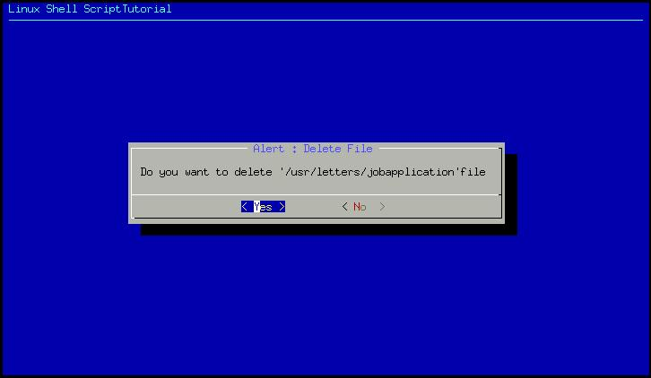
yesno box using dialog utility

Slide 104
yesno box using dialog utility
Above script creates yesno type dialog box, which is used to ask some questions to the user , and answer to those question either yes or no.
After asking question how do we know, whether user has press yes or no button ?
The answer is exit status, if user press yes button exit status will be zero, if user press no button exit status will be one and if user press Escape key to cancel dialog box exit status will be one 255.
That is what we have tested in our above shell script as

Slide 105
Message box (msgbox) using dialog utility
$cat > dia3
dialog --title "Linux Dialog Utility Msgbox" --backtitle "Linux Shell Script\
Tutorial" --msgbox "This is dialog box called msgbox, which is used\
to show some information on screen which has also Ok button, Thanks to Savio Lam\
and Stuart Herbert to give us this utility. Press any key. . . " 9 50

Slide 106
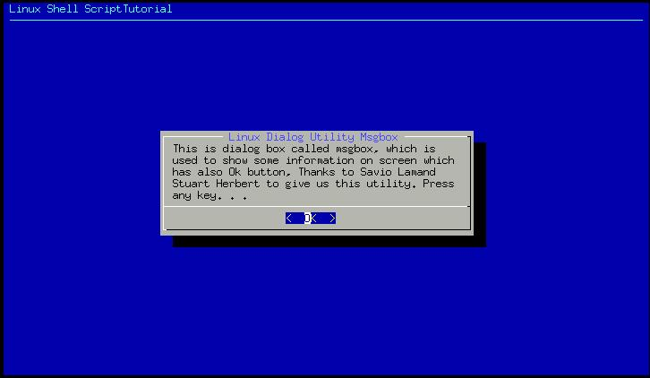
yesno box using dialog utility

Slide 107
Input Box (inputbox) using dialog utility
$ cat > dia4
dialog --title "Inputbox - To take input from you" --backtitle "Linux Shell\
Script Tutorial" --inputbox "Enter your name please" 8 60 2>/tmp/input.$$
sel=$?
na=`cat /tmp/input.$$`
case $sel in
0) echo "Hello $na" ;;
1) echo "Cancel is Press" ;;
255) echo "[ESCAPE] key pressed" ;;
esac
rm -f /tmp/input.$$

Slide 108
Input Box (inputbox) using dialog utility
Inputbox is used to take input from user, In this example we are taking Name of user as input.
But where we are going to store inputted name, the answer is to redirect inputted name to file via statement 2>/tmp/input.$$ at the end of dialog command, which means send screen output to file called /tmp/input.$$, letter we can retrieve this inputted name and store to variable as follows
na=`cat /tmp/input.$$`.

Slide 109
User Interface using dialog Utility - Putting it all together
Its time to write script to create menus using dialog utility, following are menu items
Date/time
Calendar
Editor

Slide 110
User Interface using dialog Utility - Putting it all together
$ cat > smenu
#
#How to create small menu using dialog
#
dialog --backtitle "Linux Shell Script Tutorial " --title "Main\
Menu" --menu "Move using [UP] [DOWN],[Enter] to\
Select" 15 50 3\
Date/time "Shows Date and Time"\
Calendar "To see calendar "\
Editor "To start vi editor " 2>/tmp/menuitem.$$
menuitem=`cat /tmp/menuitem.$$`
opt=$?
case $menuitem in
Date/time) date;;
Calendar) cal;;
Editor) vi;;
esac

Slide 111
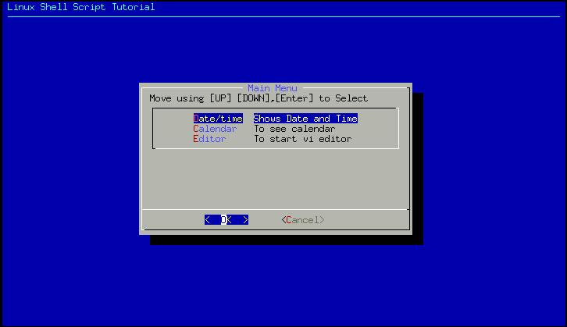
yesno box using dialog utility

Slide 112
The shift Command
The shift command moves the current values stored in the positional parameters (command line args) to the left one position. For example, if the values of the current positional parameters are:
$1 = -f $2 = foo $3 = bar
and you executed the shift command the resulting positional parameters would be as follows:
$1 = foo $2 = bar

Slide 113
The shift Command example
$ vi shiftdemo.sh
echo "Current command line args are: \$1=$1, \$2=$2, \$3=$3"
shift
echo "After shift command the args are: \$1=$1, \$2=$2, \$3=$3"

Slide 114
But where to use shift command? example
$ vi convert
while [ "$1" ]
do
if [ "$1" = "-b" ]; then
ob="$2"
case $ob in
16) basesystem="Hex";;
8) basesystem="Oct";;
2) basesystem="bin";;
*) basesystem="Unknown";;
esac
shift 2
elif [ "$1" = "-n" ]
then
num="$2"
shift 2
else
echo "Program $0 does not recognize option $1"
exit 1
fi
done
output=`echo "obase=$ob;ibase=10; $num;" | bc`
echo "$num Decimal number = $output in $basesystem number system(base=$ob)"

Slide 115
But where to use shift command? example
run the above shell script as follows:
$ ./convert -b 16 -n 500
500 Decimal number = 1F4 in Hex number system(base=16)
$ ./convert -b 8 -n 500
500 Decimal number = 764 in Oct number system(base=8)
$ ./convert -b 2 -n 500
500 Decimal number = 111110100 in bin number system(base=2)
Three sample run converts the number 500 ( -n 500 ) to respectively 1F4 (hexadecimal number i.e. -b 16), 764 (octal number i.e. -b 16) , 111110100 (binary number i.e. -b 16).
It use -n and -b as command line option which means:
-b {base-system i.e. 16,8,2 to which -n number to convert}
-n {Number to convert to -b base-system}

Slide 116
But where to use shift command? example
run the above shell script as follows:
$ ./convert -b 2 -v 500
Program ./convert does not recognize option -v
$ ./convert -t 2 -v 500
Program ./convert does not recognize option –t
Fourth and fifth sample run produce the error "Program ./convert does not recognize option -v". This is because these two (-v & -t) are not the valid command line option.

Slide 117
But where to use shift command? example
run the above shell script as follows:
$ ./convert -b 4 -n 500
500 Decimal number = 13310 in Unknown number system(base=4)
Sixth sample run produced output "500 Decimal number = 13310 in Unknown number system(base=4)". Because the base system 4 is unknown to our script.

Slide 118
bc: Hexadecimal or Binary Conversion
One thing that's really handy to know about bc is how to use it for base conversion.
By default, bc takes its input and prints its output in decimal.
However, you can set either the input or the output to be some other base numbering system - for example, hexadecimal or binary - using the ibase and obase commands.

Slide 119
bc: Hexadecimal or Binary Conversion
For example, to find the decimal equivalents to a hexadecimal number, set ibase to 16, and leave obase alone (i.e., as decimal).
Simply type the number (or a series of numbers separated by semicolons) you want converted, and press RETURN.
The decimal equivalent will be printed below.

Slide 120
bc: Hexadecimal or Binary Conversion
(Hexadecimal numbers from A to F must be typed in uppercase, or bc will report an error.) For example:
  $ bc
  ibase=16
  B6;7F;FFF
  182
  127
  4095

Slide 121
bc: Hexadecimal or Binary Conversion
Or if you wanted to convert to hexadecimal, you'd set obase to 16, and leave ibase at 10:
$ bc
    obase=16
    142
    8E
Or, to convert binary to hexadecimal, set ibase=2 and obase=16 (or ibase=16 and obase=2 for the reverse operation):
  $ bc
    obase=16
    ibase=2
    11010001
    D1
Type CTRL-d to exit bc. Be careful to set obase before ibase, or you will have problems

Slide 122
getopts command
This command is used to check valid command line argument are passed to script. Usually used in while loop.
Syntax:
getopts {optsring} {variable1}
getopts is used by shell to parse command line argument.

Slide 123
getopts command
getopts {optsring} {variable1}
optstring contains the option letters to be recognized
If a letter is followed by a colon, the option is expected to have an argument, which should be separated from it by white space.
Each time it is invoked, getopts places the next option in the shell variable variable1
When an option requires an argument, getopts places that argument into the variable OPTARG
On errors getopts diagnostic messages are printed when illegal options or missing option arguments are encountered

Slide 124
getopts command example –script-part-1
$ vi ani
#
# Usage: ani -n -a -s -w -d
#
#
# help_ani() To print help
#
help_ani()
{
echo "Usage: $0 -n -a -s -w -d"
echo "Options: These are optional argument"
echo " -n name of animal"
echo " -a age of animal"
echo " -s sex of animal "
echo " -w weight of animal"
echo " -d demo values (if any of the above options are used "
echo " their values are not taken)"
exit 1
}

Slide 125
getopts command example –script-part-2
#
#Start main procedure
#
#
#Set default value for variable
#
isdef=0
na=Moti
age="2 Months" # may be 60 days, as U like it!
sex=Male
weight=3Kg

Slide 126
getopts command example –script-part-3
#
#if no argument
#
if [ $# -lt 1 ]; then
help_ani
fi
while getopts n:a:s:w:d opt
do
case "$opt" in
n) na="$OPTARG";;
a) age="$OPTARG";;
s) sex="$OPTARG";;
w) weight="$OPTARG";;
d) isdef=1;;
\?) help_ani;;
esac
done

Slide 127
getopts command example –script-part-4
if [ $isdef -eq 0 ]
then
echo "Animal Name: $na, Age: $age, Sex: $sex, Weight: $weight (user define mode)"
else
na="Pluto Dog"
age=3
sex=Male
weight=20kg
echo "Animal Name: $na, Age: $age, Sex: $sex, Weight: $weight (demo mode)"
fi

Slide 128
Advanced Unix Commands: Sed and AWK.
sed and awk are two very powerful tools that enable a user to manipulate files in an efficient manner
  sed: a text editor that works on full streams of text
  AWK: an output formatting language

Slide 129
Sed
Sed is a stream editor (thus the name), and it is designed to work on a specified stream of text according to rules set by the user beforehand
For example, the output of the ls command produces a stream of text—a directory listing— that can be piped through sed and edited.
In addition, sed can work on files.
If you have a group of files with similar content and need to make a particular edit to the contents of all these files, sed will enable you to do that very easily.

Slide 130
Sed example
Here you combine the contents of two files while at the same time performing a substitution for the name “Paul” in both files.

Slide 131
Sed example
1. Create two files, each with a list of first names, in vi:
$ vi names1.txt
  Paul
  Craig
  Debra
  Joe
  Jeremy
$ vi names2.txt
  Paul
  Katie
  Mike
  Tom
  Pat

Slide 132
Sed example
2. At the command line enter and run the following command:
$ sed s/Paul/Pablo/g names1.txt names2.txt > names3.txt
3. Display the output of the third file to discover the resulting list of names:
Note:g specifies that sed should look globally.
Without that trailing g, if the name Paul happened to be on the same line twice, only the first would be substituted.

Slide 133
Sed
Using the -e Option
Multiple commands may be specified by using the -e option:
sed -e ‘s/Paul/Pablo/; s/Pat/Patricia/’ names1.txt names2.txt

Slide 134
Sed
Using the -e Option
There are three ways for providing a series of editing instructions for sed to process at the command line.
One way is to use the semicolon, such as in the previous example, to separate editing instructions.
Another is to precede each individual editing argument with the -e switch, like this:
  $ sed -e ‘s/Paul/Pablo/g’ -e ‘s/Pat/Patricia/g’ names1.txt names2.txt

Slide 135
Sed
Using the -e Option
A third option is to use the multiple-line entry capability of the shell
The following is how that would appear within the Bash shell environment, but not C shell:
$ sed ‘
> s/Paul/Pablo/
> s/Pat/Patricia/ names1.txt names2.txt’

Slide 136
Sed Files
Of course, no matter which of the three methods just described is used, none are practical when it comes time to enter a long list of editing commands for sed on the command line.
To provide a large series of commands, sed has the capability to read a file full of commands that contains the editing instructions as a single command-line argument.
This is done using the -f option.
The file denoted with the -f argument simply specifies a text file with a series of actions to be performed in sequence.

Slide 137
Sed Files example
Create a new file with vi called edits.sedscr and list a series of editing instructions for sed:
$ vi edits.sedscr
  s/Pat/Patricia/
  s/Tom/Thomas/
  s/Joe/Joseph/
sed -f edits.sedscr names1.txt names2.txt > names3.txt

Slide 138
AWK
AWK, offers a more general computational model for processing a file
Atypical example of an AWK program is one that transforms data into a formatted report.
The data might be a log file generated by a Unix program such as traceroute, and the report might summarize the data in a format useful to a system administrator
Or the data might be extracted from a text file with a specific format, such as the following example.
In other words, AWK is a pattern-matching program

Slide 139
Use AWK
Try out this one awk command at the command line:
$ awk ‘{ print $0 }’ /etc/passwd
The results will look something like the following
  root:x:0:0:root:/root:/bin/bash
  bin:x:1:1:bin:/bin:/sbin/nologin
  sync:x:5:0:sync:/sbin:/bin/sync
  shutdown:x:6:0:shutdown:/sbin:/sbin/shutdown

Slide 140
Use AWK
AWK takes two inputs: a command, set of commands, or a command file and a data or data file.
As with sed the command or command file contains pattern-matching instructions for which AWK is to use as a guideline for processing the data or data file.
In this example, AWK isn’t processing any data but is simply reading the /etc/passwd file’s contents and sending the data unfiltered to standard out, much like the cat command.

Slide 141
Extracting with AWK
The real working power of AWK is in extracting parts of data from a larger formatted body.
Using the /etc/passwd file again, the following command takes two of the fields from each entry in the /etc/passwd file and creates a more human-friendly output:
$ awk -F”:” ‘{ print “username: “ $1 “\t\t\t user id:” $3 }’ /etc/passwd

Slide 142
Extracting with AWK
By default AWK associates a blank space as a delimiter for the incoming data
To change this association the -F switch is used to denote a different field separator
the colon, for example, is the field separator in the /etc/passwd file. So the quotation marks around the colon, directly following the -F switch denote the delimiter that is in use.
$1 and $2 … are used as fields by AWK. $0 represents the whole line.

Slide 143
Use an AWK File
1. Use vi to enter the following and save the file as print.awk:
  BEGIN {
  FS=”:”
  }
  { printf “username: “ $1 “\t\t\t user id: $3 }
2. Execute awk as follows:
$ awk -f print.awk /etc/passwd

Slide 144
Use an AWK File explanation
The script as executed performs the same function as the previous example; the difference here is the commands reside within a file, with a slightly different format.
Because AWK is a structured programming language, there is a general format to the layout of the file:

Slide 145
Use an AWK File explanation
1. Beginning commands, which are executed only once at the beginning of the file, are set into a block starting with the word BEGIN. The block is contained in braces exactly as the example shows:
  BEGIN {
  FS=”:”
  }

Slide 146
Use an AWK File explanation
2. Pattern-matching commands are blocks of commands that are executed once for each and every line in the data file. Here’s an example:
{ printf “username: “ $1 “\t\t\t user id: $3 }
3. Ending commands, a block of commands first denoted by the word END, are executed only once, when the end of file is reached.
  END {
  Printf “All done processing /etc/passwd”
  }

